Slide 1

Data Structures & Algorithms
Week-03

Slide 2
Week-03 Agenda
Single Linked List
Doubly Linked List
Circular Linked List
Operations on Linked List

Slide 3
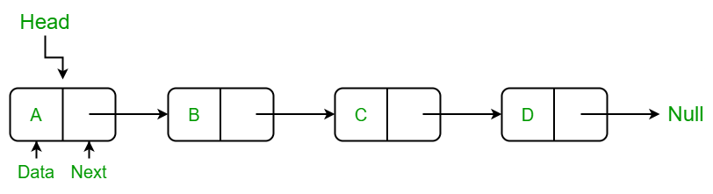
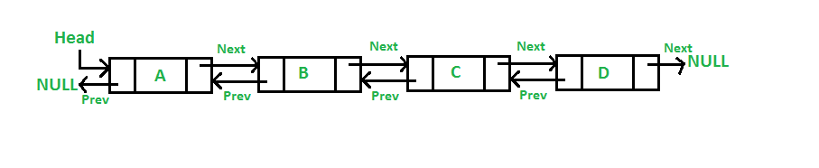
Linked Lists
Linked Lists: A collection of nodes, where each node contains data and a reference (or pointer) to the next node in the sequence.
Linked lists can be singly linked (forward only) or doubly linked (forward and backward).

Slide 4
Single Linked Lists
A Singly Linked List is a linear data structure where each element (node) contains two parts: data and a pointer to the next node in the sequence. It allows traversal in one direction only.
Operations and Time Complexity:
  Insertion at the beginning: O(1)
  Insertion at the end: O(n)
  Deletion: O(n)
  Search: O(n)
  Traversal: O(n)

Slide 5
Single Linked Lists

Slide 6
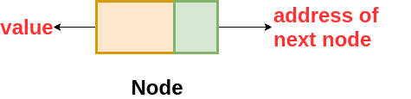
Single Linked Lists
A Singly-linked list is a collection of nodes linked together in a sequential way where each node of the singly linked list contains a data field and an address field that contains the reference of the next node.
The structure of the node in the Singly Linked List is

Slide 7
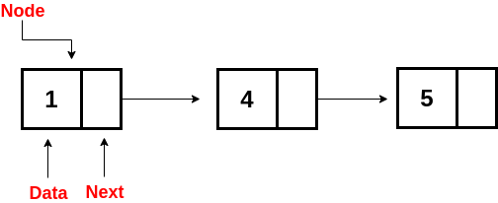
Single Linked Lists
The nodes are connected to each other in this form where the value of the next variable of the last node is NULL i.e. next = NULL , which indicates the end of the linked list.

Slide 8
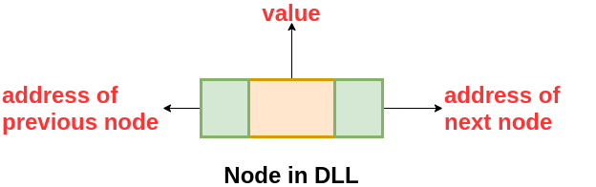
Double Linked Lists
A Doubly Linked List contains an extra memory to store the address of the previous node, together with the address of the next node and data which are there in the singly linked list. So, here we are storing the address of the next as well as the previous nodes.
The following is the structure of the node in the Doubly Linked List(DLL):

Slide 9
Double Linked Lists
A Doubly Linked List is a linear data structure where each node contains three parts: data, a pointer to the next node, and a pointer to the previous node. It allows traversal in both directions (forward and backward).
Operations and Time Complexity:
  Insertion at the beginning: O(1)
  Insertion at the end: O(1)
  Deletion: O(1) for the head and tail, O(n) for any arbitrary node
  Search: O(n)O(n)O(n)
  Traversal: O(n)

Slide 10
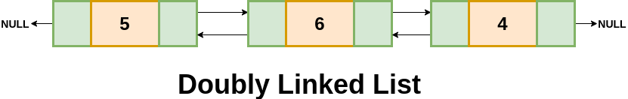
Double Linked Lists
The nodes are connected to each other in this form where the first node has prev = NULL and the last node has next = NULL .

Slide 11
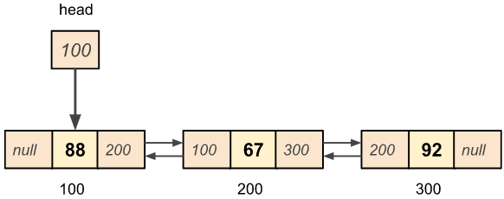
Double Linked List
100, 200, & 300 are memory locations.
88, 67, & 92 are data values.

Slide 12
Circular Linked Lists
A circular linked list is either a singly or doubly linked list in which there are no NULL values.
Here, we can implement the Circular Linked List by making use of Singly or Doubly Linked List.
In the case of a singly linked list, the next of the last node contains the address of the first node, and in the case of a doubly-linked list, the next of last node contains the address of the first node and prev of the first node contains the address of the last node.

Slide 13
Circular Linked Lists
A Circular Linked List is a variation where the last node points back to the first node, forming a circular structure. It can be either singly or doubly linked.
Operations and Time Complexity:
  Insertion at the beginning: O(1)
  Insertion at the end: O(n)
  Deletion: O(n)
  Search: O(n)
  Traversal: O(n)

Slide 14
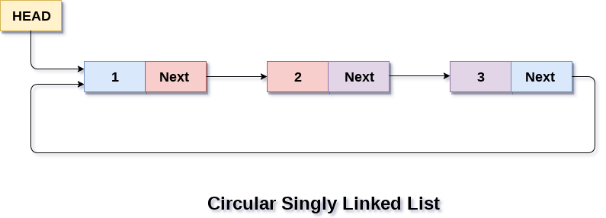
Circular Linked Lists

Slide 15
Operations on Linked Lists
Traversal: To traverse all the nodes one after another.
Insertion: To add a node at the given position.
Deletion: To delete a node.
Searching: To search an element(s) by value.
Updating: To update a node.
Sorting: To arrange nodes in a linked list in a specific order.
Merging: To merge two linked lists into one.

Slide 16
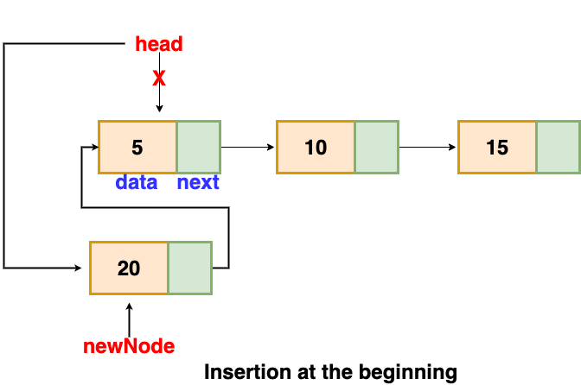
Operations on Linked Lists

Slide 17
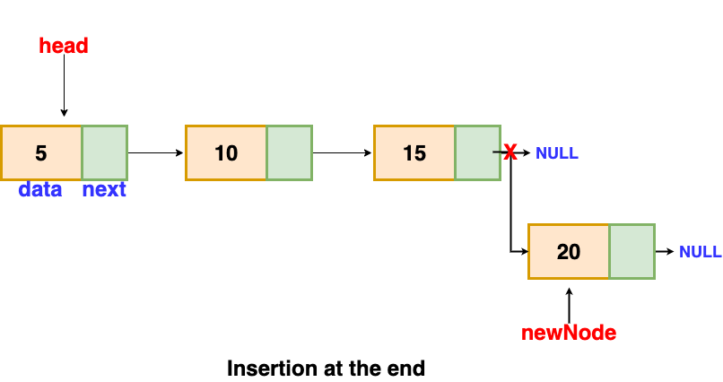
Operations on Linked Lists

Slide 18
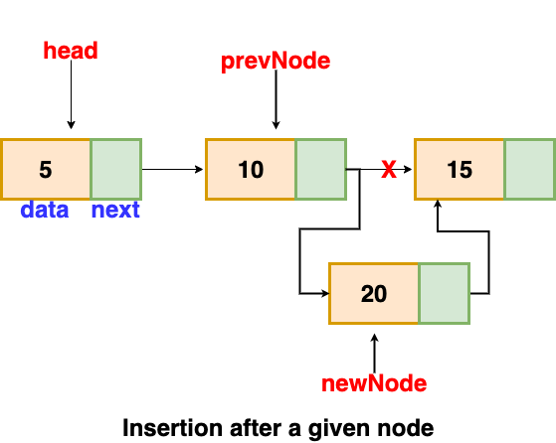
Operations on Linked Lists

Slide 19
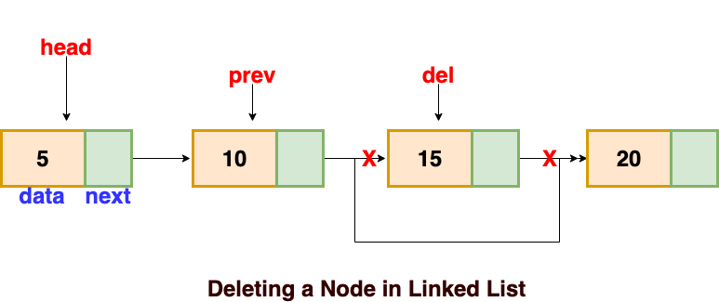
Operations on Linked Lists

Slide 20


